Slide 1
Target
: Methodology 1
: Effect
Please send your input to: kuboki@mce.uec.ac.jp
Methodology 2
: Methodology 2
Application
Application
Related:
Author, reference

Slide 2
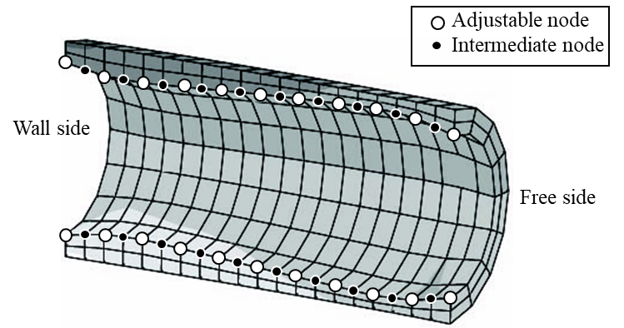
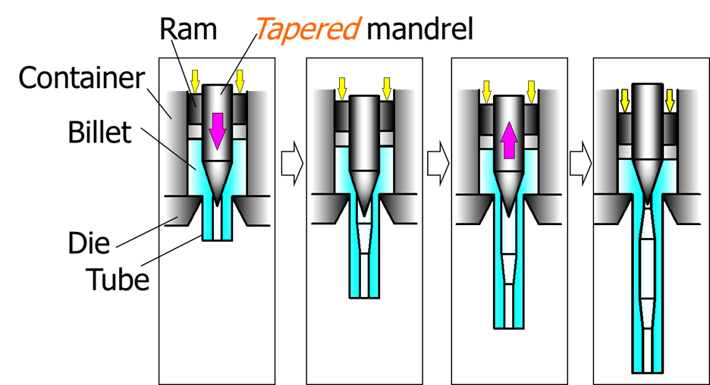
Light weight and strength/rigidity, now available
: Shape optimization
: Light weight & high strength
Thickness variation will be given according to the stress magnitude under operation.
: Unique extrusion
Thick
Thin
Thick
Methodology 2
Application
Light transportation systems.
Reduction of CO₂.
Kuboki, T. et al., Thickness optimization of axisymmetric tube by three-dimensional finite-element analysis for high-flexural rigidity, Proc. Instn Mech. Engrs, Part C, J. of Mech. Eng. Sci., 220-4:473-482.
Makiyama, T et al., "effects of taper angle on extrusion for changing wall thickness of tube with tapered mandrel, J. Jpn. Soc. Technol. Plast., 45-524:737-741.

